Slide 1
CRYPTOGRAPHY and network security PEC-CS801B, UNIT 2
By
CHINMOY GHOSH
Assntt. Professor,
Deptt. Of CSE, JGEC

Slide 2
Introduction
Security is about how to prevent attacks, or -- if prevention is not possible -- how to detect attacks and recover from them
An attack is a deliberate attempt to compromise a system; it usually exploits weaknesses in the system’s design, implementation, operation, or management
attacks can be
passive
attempts to learn or make use of information from the system but does not affect system resources
examples: eavesdropping message contents, traffic analysis
difficult to detect, should be prevented
active
attempts to alter system resources or affect their operation
examples: masquerade (spoofing), replay, modification (substitution, insertion, destruction), denial of service
difficult to prevent, should be detected
A.1 Introduction

Slide 3
Cryptography
Cryptography is the art and science of achieving security by encoding message to make them non-readable.
Cryptography issues:
1. Confidentiality: only sender, intended receiver should “understand” message contents
sender encrypts message
receiver decrypts message
2. End-Point Authentication: sender, receiver want to confirm identity of each other
3. Message Integrity: sender, receiver want to ensure message not altered (in transit, or afterwards) without detection

Slide 4
Basic Terminologies
Cryptography deals with creating documents that can be shared secretly over public communication channels
Cryptographic documents are decrypted with the key associated with encryption, with the knowledge of the encryptor.
The word cryptography comes from the Greek words: Krypto (secret) and graphein (write).
Cryptanalysis deals with finding the encryption key without the knowledge of the encryptor.

Slide 5
Basic Terminologies
Keys are rules used in algorithms to convert a document into a secret document
Keys are of two types:
Symmetric
Asymmetric
A key is symmetric if the same key is used both for encryption and decryption
A key is asymmetric if different keys are used for encryption and decryption
Plaintext is text that is in readable form
Ciphertext results from plaintext by applying the encryption key

Slide 6



Friends and enemies: Alice, Bob, Trudy
well-known in network security world
Bob, Alice (lovers!) want to communicate “securely”
Trudy (intruder) may intercept, delete, add messages
Alice
Bob
channel
data, control messages
secure
sender
secure
receiver
data
data
Trudy

Slide 7
Who might Bob, Alice be?
… well, real-life Bobs and Alices!
Web browser/server for electronic transactions (e.g., on-line purchases)
on-line banking client/server
DNS servers
routers exchanging routing table updates

Slide 8
The language of cryptography
Alice’s
encryption
key
Bob’s
decryption
key
K
K
A
B
plaintext
encryption
algorithm
ciphertext
decryption
algorithm
plaintext
m plaintext message
K_{A}(m) ciphertext, encrypted with key K_{A}
m = K_{B}(K_{A}(m))

Slide 9
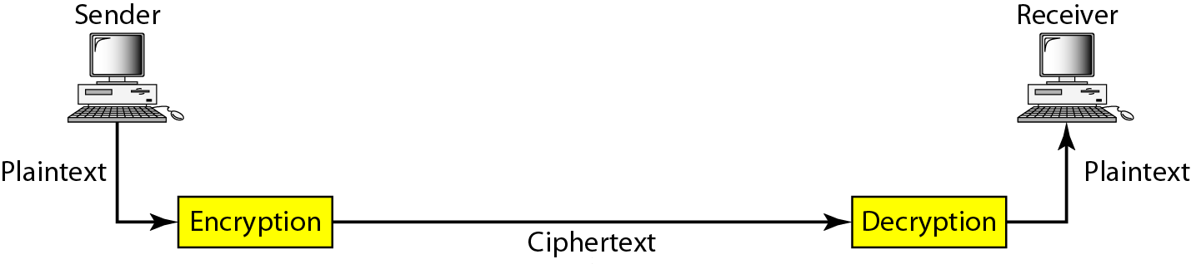
Cryptography components

Slide 10
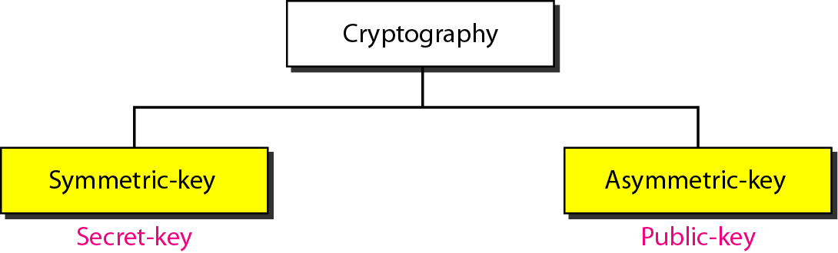
Categories of cryptography

Slide 11
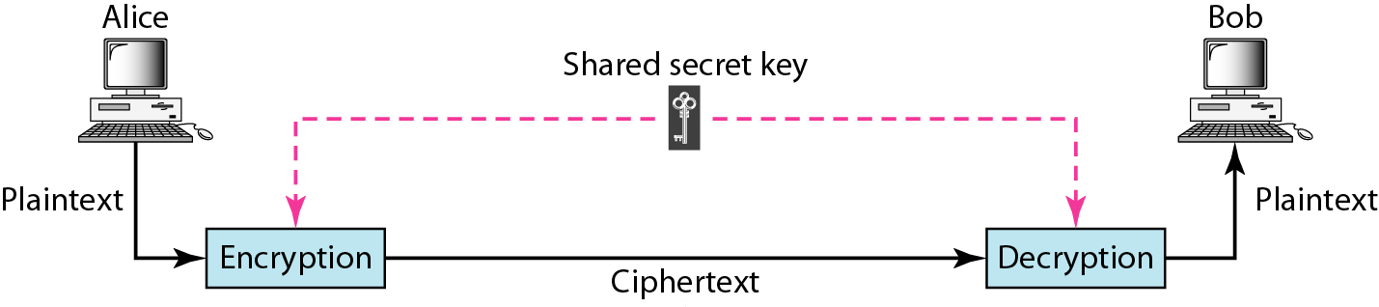
Figure 30.3 Symmetric-key cryptography
In symmetric-key cryptography, the same key is used by the sender
(for encryption) and the receiver (for decryption).
The key is shared.

Slide 12
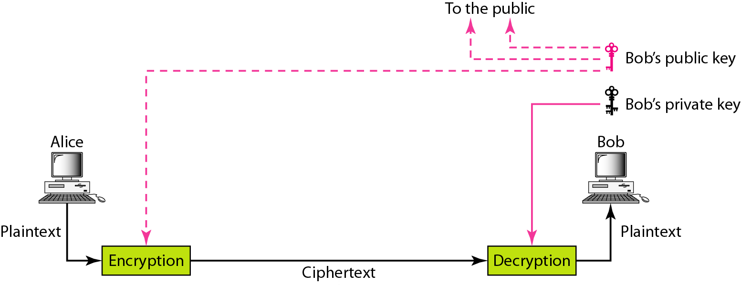
Figure 30.4 Asymmetric-key cryptography

Slide 13
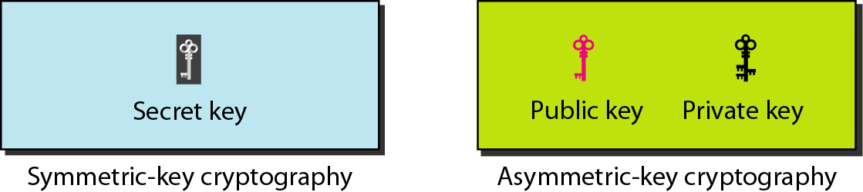
Figure 30.5 Keys used in cryptography

Slide 14
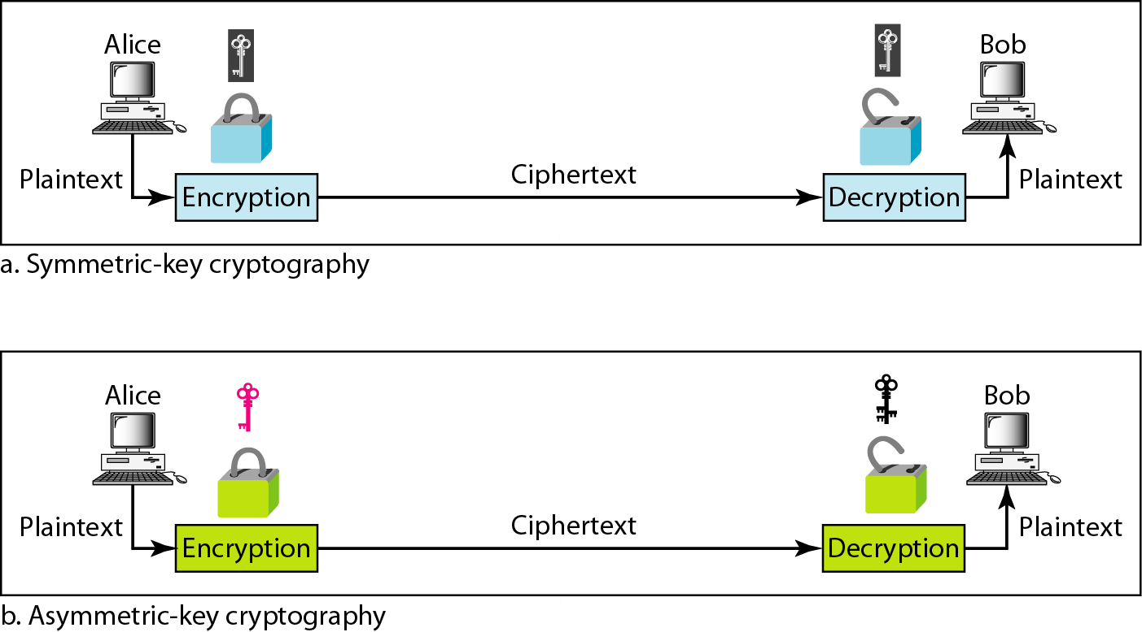
Figure 30.6 Comparison between two categories of cryptography

Slide 15
SYMMETRIC-KEY CRYPTOGRAPHY
Symmetric-key cryptography started thousands of years ago when people needed to exchange secrets (for example, in a war). We still mainly use symmetric-key cryptography in our network security.
There are two ways in which a plain text message can be codified to obtain the corresponding cipher text:
Substitution
Transposition

Slide 16
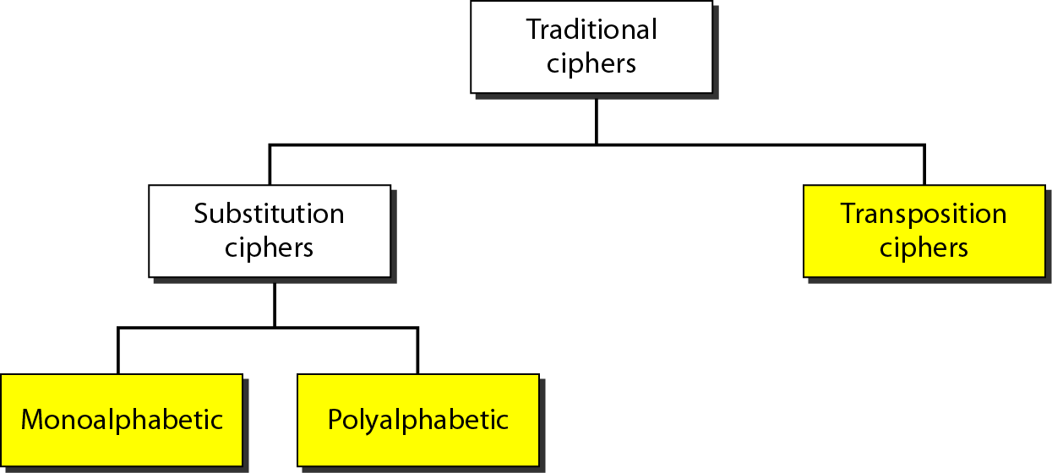
Figure 30.7 Traditional ciphers

Slide 17
Substitution Cipher
A substitution cipher replaces one symbol with another.
Mono-alphabetic (Caesar Cipher)
Homophonic
Polygram
* Playfair Cipher
Polygram substitution technique replaces one block of plain text with a block of cipher text, it does not work on a character-by-character basis.

Slide 18
Example 30.1
The following shows a plaintext and its corresponding ciphertext. Is the cipher monoalphabetic?
Solution
The cipher is probably monoalphabetic because both occurrences of L’s are encrypted as O’s.

Slide 19
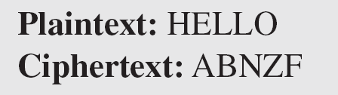
Example 30.2
The following shows a plaintext and its corresponding ciphertext. Is the cipher monoalphabetic?
Solution
The cipher is not monoalphabetic because each occurrence of L is encrypted by a different character. The first L is encrypted as N; the second as Z.

Slide 20
Example 30.3
Use the shift cipher with key = 15 to encrypt the message “HELLO.”
Solution
We encrypt one character at a time. Each character is shifted 15 characters down. Letter H is encrypted to W. Letter E is encrypted to T. The first L is encrypted to A. The second L is also encrypted to A. And O is encrypted to D. The cipher text is WTAAD.

Slide 21
Example 30.4
Use the shift cipher with key = 15 to decrypt the message “WTAAD.”
Solution
We decrypt one character at a time. Each character is shifted 15 characters up. Letter W is decrypted to H. Letter T is decrypted to E. The first A is decrypted to L. The second A is decrypted to L. And, finally, D is decrypted to O. The plaintext is HELLO.

Slide 22
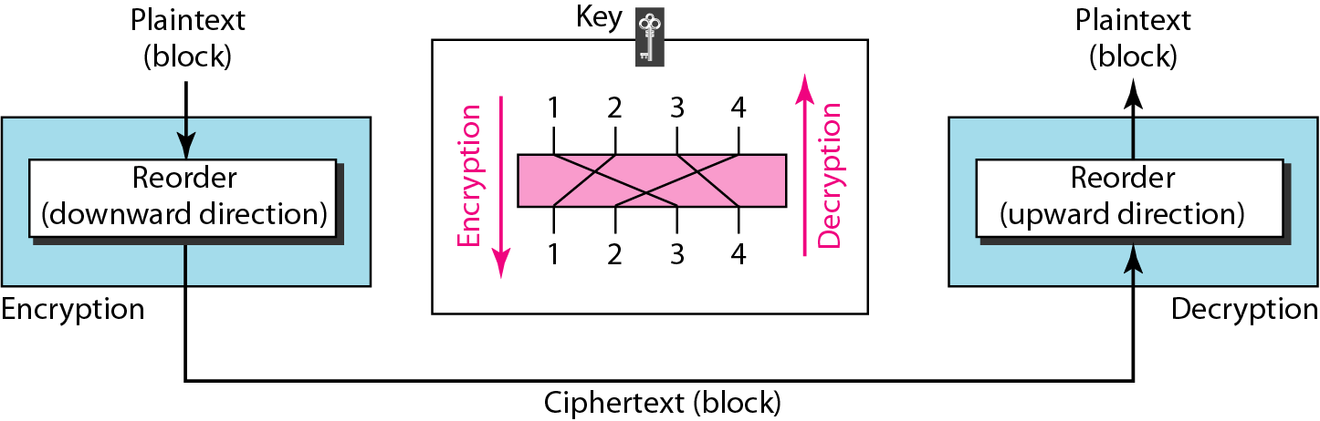
Figure 30.8 Transposition cipher

Slide 23
Transposition Cipher
In transposition Cipher, there is no substitution of character; instead their location change.
Rail Fence Techniques.
Simple Columnar transposition Technique.
Vernum Cipher (One time pad) .

Slide 24
31-1 SECURITY SERVICES
Network security can provide five services. Four of these services are related to the message exchanged using the network. The fifth service provides entity authentication or identification.
Topics discussed in this section:
Message Confidentiality Message Integrity Message Authentication Message Nonrepudiation
Entity Authentication

Slide 25
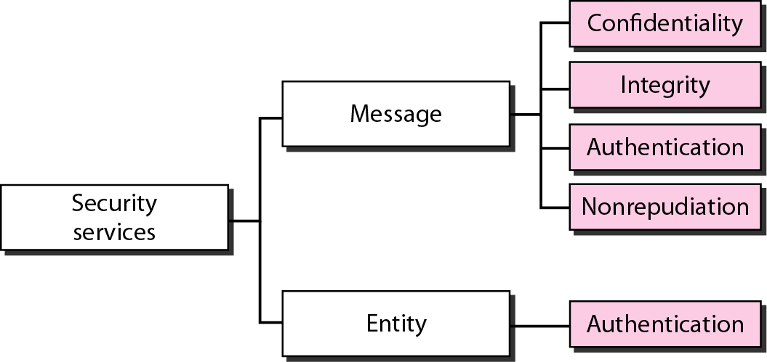
Figure 31.1 Security services related to the message or entity

Slide 26
31-2 MESSAGE CONFIDENTIALITY
The concept of how to achieve message confidentiality or privacy has not changed for thousands of years. The message must be encrypted at the sender site and decrypted at the receiver site. This can be done using either symmetric-key cryptography or asymmetric-key cryptography.
Topics discussed in this section:
Confidentiality with Symmetric-Key Cryptography
Confidentiality with Asymmetric-Key Cryptography

Slide 27
31-3 MESSAGE INTEGRITY
Encryption and decryption provide secrecy, or confidentiality, but not integrity. However, on occasion we may not even need secrecy, but instead must have integrity.
Topics discussed in this section:
Document and Fingerprint Message and Message Digest Creating and Checking the Digest Hash Function Criteria
Hash Algorithms: SHA-1

Slide 28

Note
To preserve the integrity of a document,
both the document and the fingerprint are needed.

Slide 29
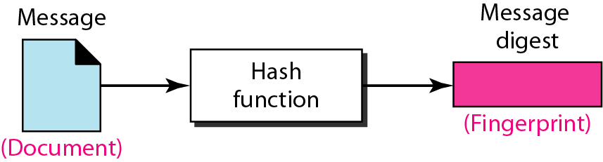
Figure 31.4 Message and message digest

Slide 30
Note
The message digest needs to be kept secret.

Slide 31
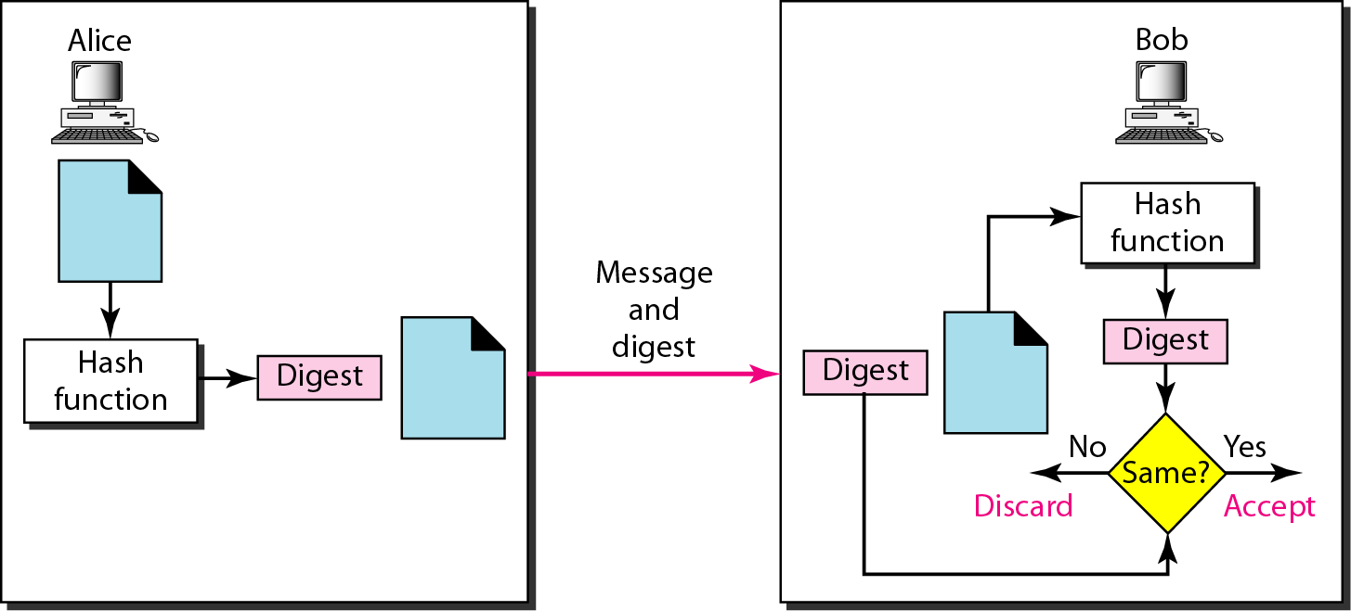
Figure 31.5 Checking integrity

Slide 32
31-4 MESSAGE AUTHENTICATION
A hash function cannot provide authentication. The digest created by a hash function can detect any modification in the message, but not authentication.
Topics discussed in this section:
MAC (Message authentication code)

Slide 33
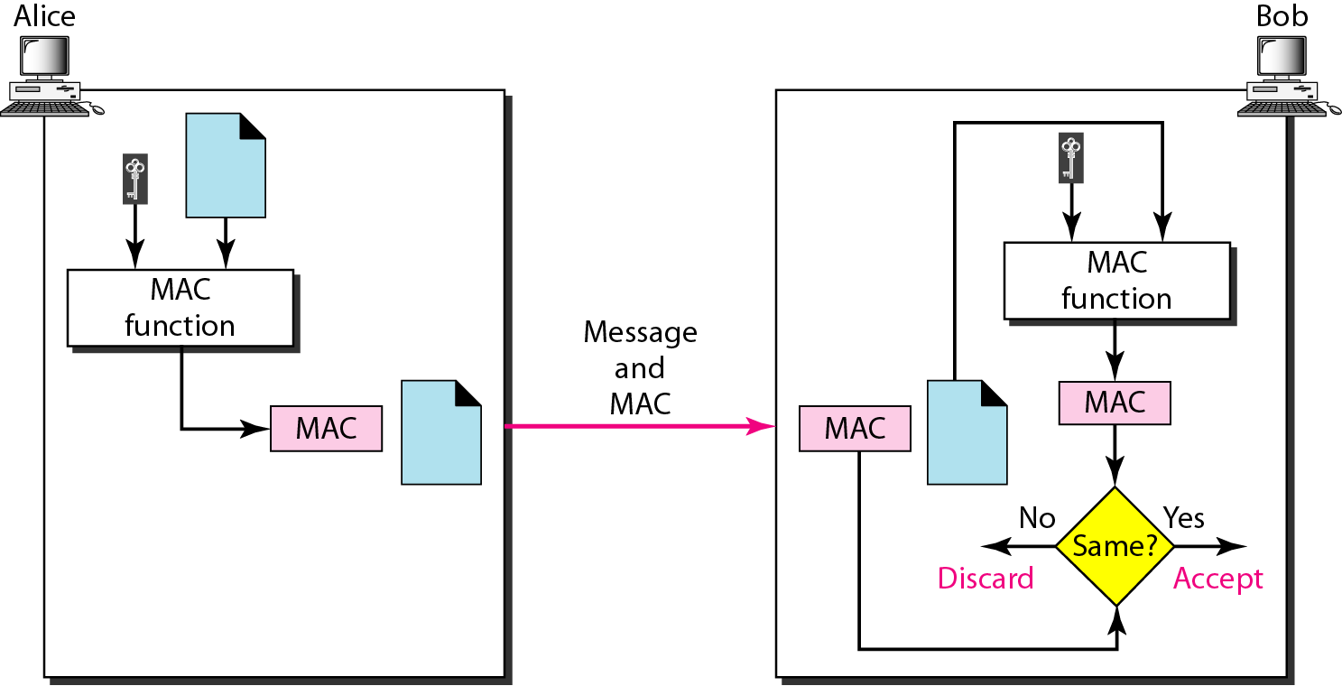
Figure 31.9 MAC, created by Alice and checked by Bob

Slide 34
31-5 DIGITAL SIGNATURE
When Alice sends a message to Bob, Bob needs to check the authenticity of the sender; he needs to be sure that the message comes from Alice and not Eve. Bob can ask Alice to sign the message electronically. In other words, an electronic signature can prove the authenticity of Alice as the sender of the message. We refer to this type of signature as a digital signature.
Topics discussed in this section:
Comparison Need for Keys Process

Slide 35
Note
A digital signature needs a public-key system.

Slide 36
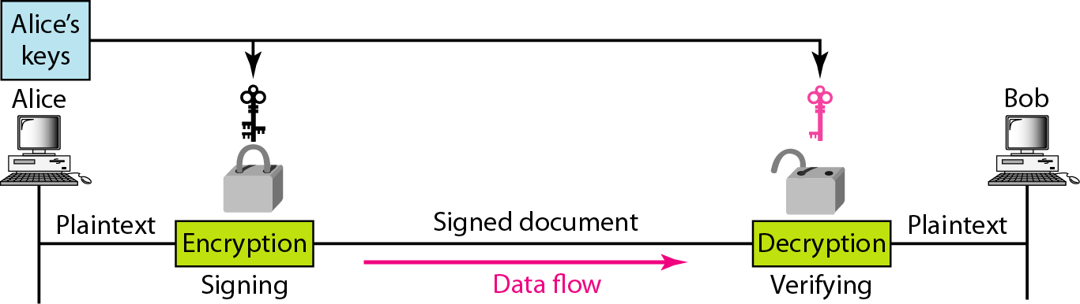
Figure 31.11 Signing the message itself in digital signature

Slide 37
Note
In a cryptosystem, we use the private and public keys of the receiver;
in digital signature, we use the private and public keys of the sender.

Slide 38
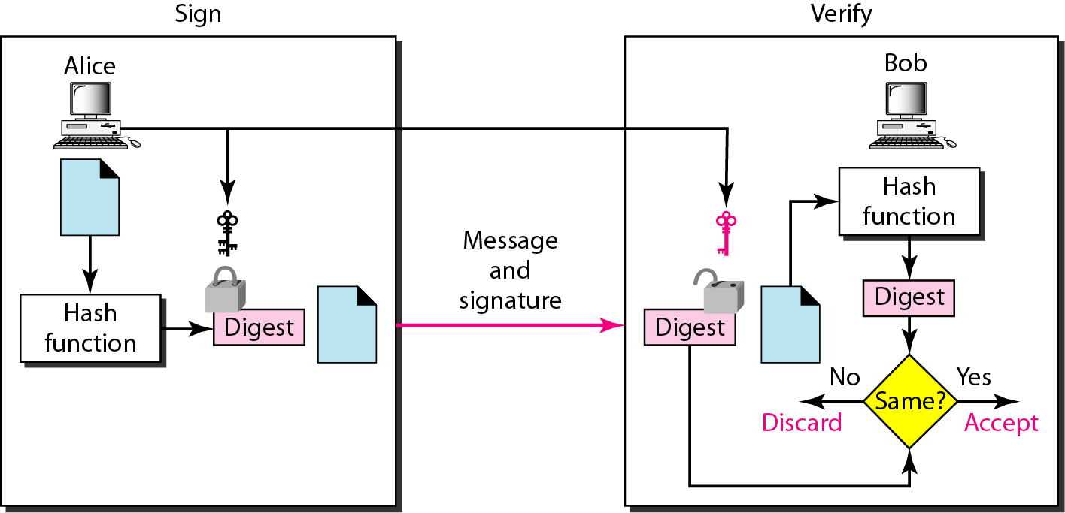
Figure 31.12 Signing the digest in a digital signature

Slide 39
Note
A digital signature today provides message integrity.

Slide 40
Note
Digital signature provides message authentication.

Slide 41
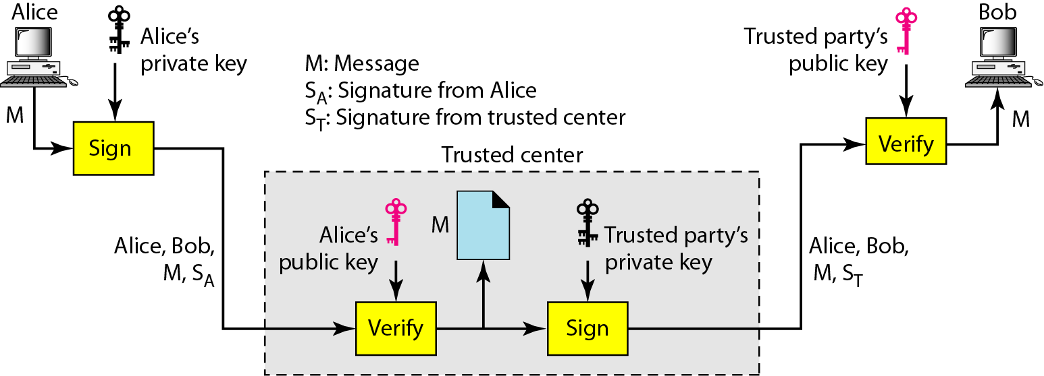
Figure 31.13 Using a trusted center for nonrepudiation

Slide 42
Note
Nonrepudiation can be provided using a trusted party.

Slide 43
31-6 ENTITY AUTHENTICATION
Entity authentication is a technique designed to let one party prove the identity of another party. An entity can be a person, a process, a client, or a server. The entity whose identity needs to be proved is called the claimant; the party that tries to prove the identity of the claimant is called the verifier.
Topics discussed in this section:
Passwords

